Slide 1



PollstreamX
FastAPI + MongoDB Based Polling/Voting System

Slide 2


Project Overview
Built using FastAPI (backend) and MongoDB (database).
Automatically generates polls every 48 hours from latest news headlines via NewsAPI.
Provides secure user authentication using JWT tokens.
Enforces one-vote-per-user policy for fairness.
Each poll is time-bound and expires after 48 hours.
Supports poll creation, voting, and result retrieval through APIs.
Uses a background timer to fetch news and create polls continuously.
Designed for high performance, scalability, and security.
Future-ready for features like custom polls, analytics, and real-time dashboards.
Do you support childhood marriage’s ?
PollstreamX

Slide 3
OBJECTIVES
1️⃣
Automated
Poll Generation
5️⃣
Real-time
Engagement
2️⃣
Modern Poll
Management System
4️⃣
Scalability & Performance
3️⃣
User Authentication
& Security
PollstreamX

Slide 4
MongoDB
Architecture
FastAPI
polling_app/
│
├── app/
│ ├── core/ # Core configuration and authentication
│ │ ├── auth.py # JWT creation & verification
│ │ └── config.py # Environment settings (via pydantic/BaseSettings)
│
│ ├── database/
│ │ └── db.py # MongoDB Motor connection and client setup
│
│ ├── models/
│ │ ├── user.py # User Pydantic & Mongo schema
│ │ └── polls.py # Poll schema (question, options, timestamps)
│
│ ├── routes/
│ │ ├── user_routes.py # Routes: /auth/register, /auth/login
│ │ └── poll_routes.py # Routes: /polls/, /vote, etc.
│
│ ├── services/
│ │ ├── services.py # Business logic: fetch news, create polls, voting
│
│ ├── utils/
│ │ ├── decorators.py # Route protection decorators (e.g., @login_required)
│ │ ├── hashing.py # Password hashing/verification (bcrypt)
│ │ └── logger.py # Custom logger for file logging
│
├── logs/
│ └── polling_app.log # App logs (info, error, requests)
│
├── main.py # App entry point (FastAPI instance, route inclusion)
├── requirements.txt # Python dependencies
├── postman_collection.json # Postman collection for testing API
App
Logger.py
Core
Database.py
Main.py
Models
Auth
Services.py
Req.txt
Utils
Config
Hashing.py
Postman
Logs
MongoDB
Decorator.py
ARCHITECTURE
PROJECT
PollstreamX

Slide 5
Technology Stack
Backend Framework
Database
FastAPI
MongoDB
Authentication
External API
JWT
NewsAPI
PollstreamX

Slide 6

External API
NewsAPI is a RESTful API that provides real-time news headlines from thousands of trusted sources like: BBC News, CNN, Bloomberg, Reuters etc.
It lets you search for current or historical news by: topic , source, country, language, keywords etc.
NewsAPI provides exactly the kind of data needed:
Up-to-date news titles
Authoritative sources
Concise headlines perfect for poll questions
PollstreamX

Slide 7
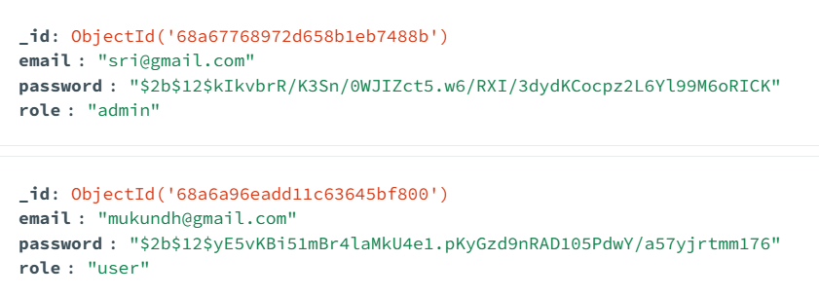
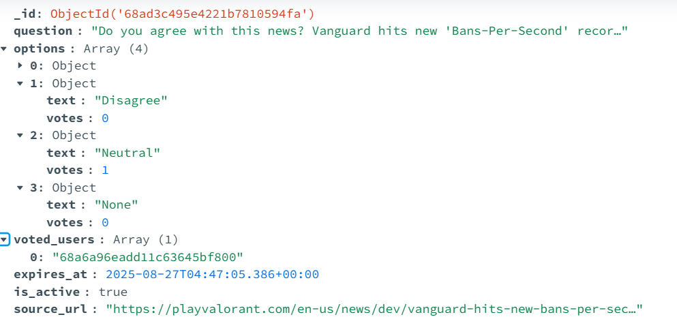
User
Polls
MongoDB DataModels
The User Model ensures secure authentication and access control.
Username(email)
hashed_password
Role
The Poll Model keeps track of poll content, voting options, vote counts, timing, and voter participation.
Question
Options
Expires_at
Votes
Polling_info
PollstreamX

Slide 8
API ENDPOINTS
Register – POST /register
Authentication endpoints
Let users securely register and log in, receiving JWT tokens for session management.
Poll endpoints
Enable users to view active polls, vote securely, and allow admins to manage polls directly.
Login – POST /login
List Polls – GET /polls
Vote – POST /polls/vote
Create Poll – POST /admin
/create_poll
Delete Poll (Admin) –
POST/admin/delete_poll
PollstreamX

Slide 9
Security considerations
Password hashing using bcrypt.
Avoiding duplicate votes by tracking voters. Allowing only one vote per user.
Securely storing sensitive information, such as the NewsAPI key and JWT secret.These secrets are kept in environment variables (commonly in a .env file) rather than hard-coded in the source code.Using Pydantic models, all incoming data—like user inputs for registration or poll creation—is strictly validated against predefined schemas. This reduces risks such as injection attacks.For password security, the system uses bcrypt hashing. Rather than storing plain-text passwords, bcrypt applies a computationally expensive hashing algorithm, making it practically impossible for attackers to reverse-engineer passwords even if they gain access to the database.
Finally, to preserve the integrity of poll voting, the system prevents duplicate votes by keeping track of users who have already voted on a poll. By maintaining a list of voter IDs, it enforces a strict one-vote-per-user rule, ensuring fair and reliable poll results.
Storing secrets (e.g., NewsAPI key, JWT secret) in .env. Which is secure and safe.
Input validation via Pydantic models.
PollstreamX

Slide 10
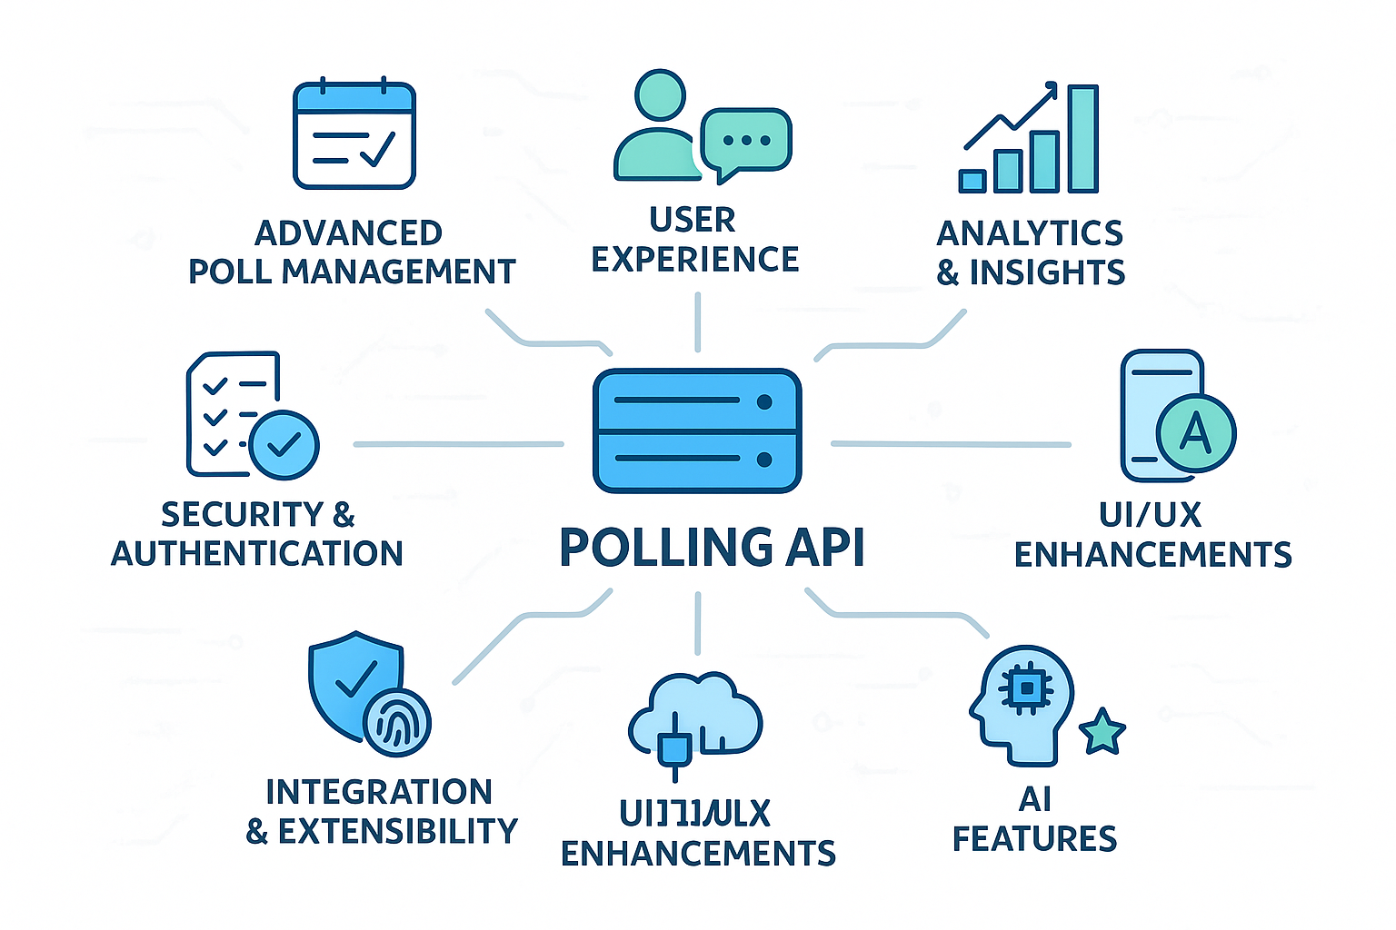
Future Enhancements
Advanced Poll Management
User Experience & Interaction
Analytics & Insights
Authentication & Security
Integration & Extensibility
AI/Smart Features
PollstreamX

